Slide 1
INTRODUCTION
The P.C.E.A church was established in the year 1891 by Thomas Watson as a branch of the Scotland church, and currently has over 4 million members.
P.C.E.A Kisauni was founded in the year 2002 in Kisauni Mombasa, it’s a part of the Eastern Region. P.C.E.A church has five regions in Kenya; the Eastern Region, Central, Mt kenya and the Rift valley Region.
The church was established with goal of spreading to the various corners of Mombasa County. The church has a huge following with congregants totaling 1000 in some of the congregation. P.C.EA Kisauni is currently divided into 4 congregations to maximize its outreach. Within the church there are 6 distinct groups which help in creating inclusion of the various sexes and age groups of the member in the church. This groups include:
*Youth Group
*Presbyterian Church Men Fellowship
*Woman’s Guild
*Church School
*Health Board
*Christian Education

Slide 2
GENESIS OF THE SYSTEM CREATION
The idea of creating the system was born out of the need to have a fast and efficient way of accessing congregant details. Having a system where with the click of a button member details would be accessed or even added.
With this in mind it was thought that having a system that does more than just house member details but also automates most of the processes done in the church would be prudent.

Slide 3
P.C.E.A KISAUNI CHURCH MANAGEMENT SYSTEM
BY GITAU BRIAN MBOGOH

Slide 4
OBJECTIVES OF THE SYSTEM
To design and implement P.C.E.A Kisauni Church Management System
To computerize congregation/Group data storage.
To computerize Sunday service scheduling and duty allocation.
To create reports on offerings and tithe collections in the church.

Slide 5
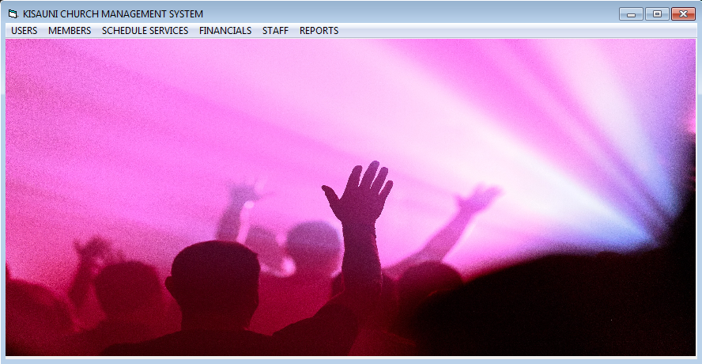
OBJECTIVE 1 Designing and implementing P.C.E.A kisauni Church Management
This objective was achieved by the successful creation of a graphical user interface that would help in the navigation of the system by the user. The interface contains buttons that help access the various parts of the system

Slide 6
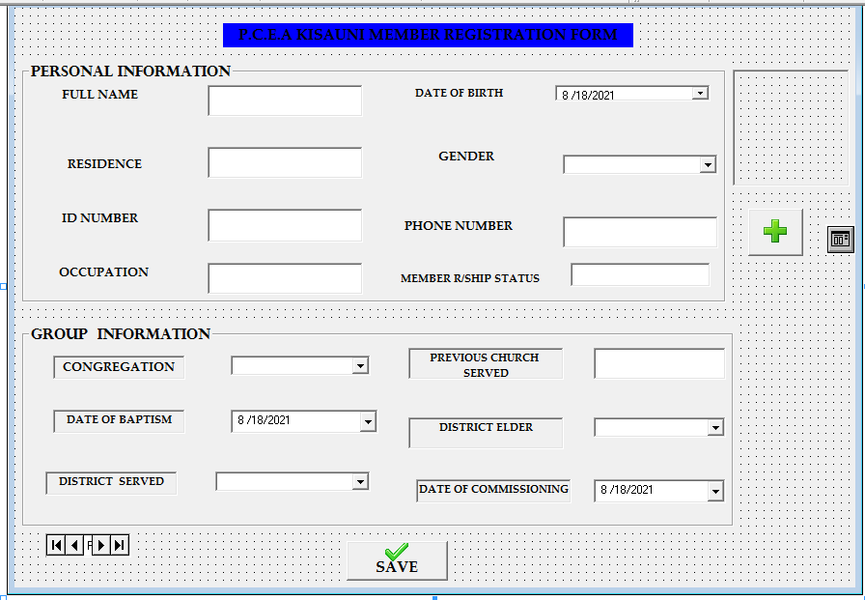
OBJECTIVE 2 COMPUTERIZING CONGREGATION/GROUP DATA STORAGE
This objective was achieved by having a form that will be used to enter all the member personal and church details, this form is connected to the system database where upon saving the details they’ll be automatically added to the systems database as well.

Slide 7
OBJECTIVE 3 COMPUTERIZE SUNDAY SERVICE SCHEDULIG
A form was created where all the details that are required to schedule a service are keyed into it then from there a finished copy would be generated and printed as seen fit by the church evangelist this copy will now be used as the service program
Details of all services will be saved in the database and reports can be generated to show all previously scheduled services.

Slide 8
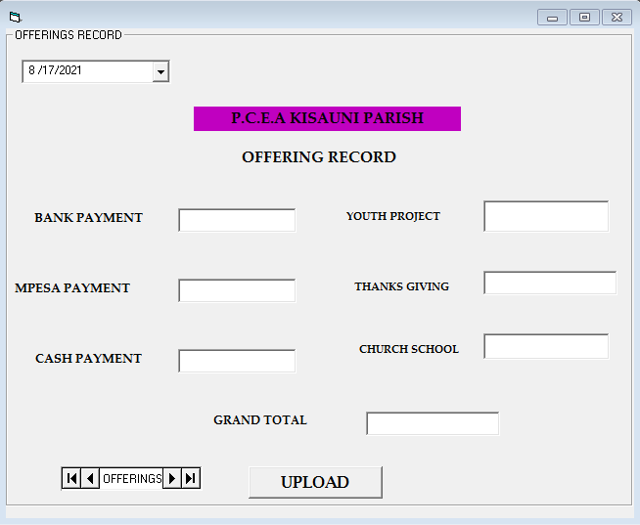
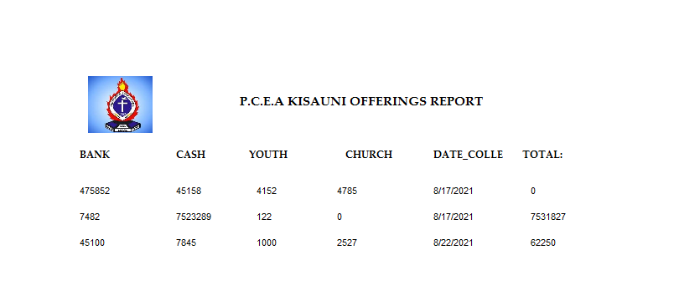
OBJECTIVE FOUR: CREATE REPORTS ON OFFERINGS AND TITHES
After offerings have been collected in the church the days collection will be saved in the database via the offerings form and reports will be then generated as per need arises.

Slide 9
ACHIEVEMENTS
Besides being able to fulfill all the four objectives of P.C.E.A Kisauni Church Management system, the system also helped in reducing the cost of operations of the church by cutting down on recurrent expenditure such as printing materials.
The system also reduced monotony in the workplace by ensuring that all repetitive jobs such as saving and recording names of members, employees was done away with.

Slide 10
LIMITATIONS
One of the major challenges experienced during my system design was the consistent errors when working with vb 6.0. Data manipulation was an issue as the visual basic program had some issues during its installation which led to some of the features to be missing

Slide 11
FUTURE IMPROVEMENTS
With the increase and growth in the programming field it would be better to use newer programming languages such as vb.Net or use of web based systems instead of using vb 6.0 . Using this new language will ensure that the system created are more dynamic and can communicate with each other over the web and also provide for creation of systems that can be used over the phone.
In the future I plan on getting my current system to be a web based system through use of Html, Css, JavaScript and other web based programming languages. I also plan on moving my system from a desktop application and make it a mobile application.

